Slide 1
MUSIC STREAMING WEBSITE
NAME: JARINA DEVASIA
ROLL NO: 22PMC129
1ST MASTER OF COMPUTER APPLICATIONS

Slide 2
ABSTRACT
It is a system that allows users to explore and listen to a wide variety of songs available on the music streaming website. The project consists of different genres and categories of music, and they are displayed in an organized manner. The user can browse through these songs and add their favorite songs to their personal collection. If the user finds a song they like, they can listen to it instantly. Once the user subscribes successfully, they gain access to a wide range of songs and exclusive content. Thus, the online music streaming project brings a comprehensive music library to users' fingertips, making it convenient and enjoyable for music lovers to discover, listen, and enjoy their favorite tunes.

Slide 3
PROJECT REQUIREMENTS
User Registration and Authentication
Song Database
Song Upload
Song Streaming
Favorites
Search and Browse
Categories
User Profile
Mobile Compatibility

Slide 4
Continue...
Performance and Scalability
Security
Analytics and Reporting

Slide 5
REQUIREMENTS LIST
User Authentication
User registration and login
Profile management
Music Management
Upload and manage songs
User Management
View and mange user profiles
Music Search And Filter
Allow users to search for songs
Add to favorites
Adding favorite songs to favorite songs
Latest songs
New and latest songs added by the admin is displayed
All songs
It displays all songs in the website
Mobile responsiveness and accessibility

Slide 6
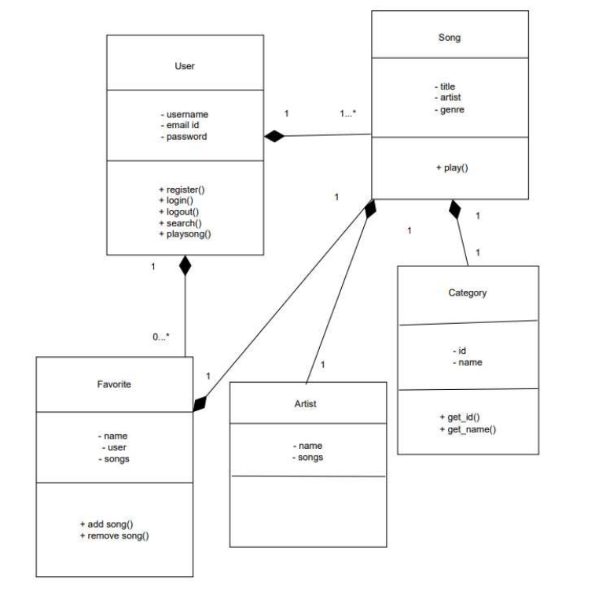
Class diagram

Slide 7
CHALLENGES FACED
Data Validation and Integrity:
Ensuring the accuracy and consistency of the data entered by users can be challenging. Validating user inputs, such as song titles, artist names, and album information, to prevent errors and inconsistencies is crucial.
Implementing proper data validation techniques, such as form validation, model validation, and data type checking, helps maintain data integrity and prevents issues with database operations.
User Experience:
Designing an intuitive and user-friendly interface is essential for a music streaming website. Providing seamless navigation, responsive layouts, and intuitive controls enhances the user experience.
Implementing features like real-time song playback, playlist management, and personalized recommendations can improve user engagement and satisfaction.
Ensuring compatibility across different devices and browsers and optimizing the website's performance for faster loading and smooth interactions is a challenge.
Testing:
Testing a Django music streaming website involves various aspects, including unit testing, integration testing, and end-to-end testing.
Testing the functionality of features like user authentication, song uploading, favorite songs creation, and search functionality ensures they work as intended.
Conducting performance testing to evaluate the website's response time, scalability, and concurrent user handling helps identify and address performance bottlenecks.

Slide 8
CONTINUE…
4. Debugging:
Identifying and resolving bugs and issues in the Django codebase can be challenging. Debugging techniques, such as logging, error tracking tools, and debugging tools integrated with the Django framework, are essential.
Analyzing error logs, handling exceptions gracefully, and implementing effective error handling mechanisms help improve the website's stability and user experience.
Data Storage and Performance:
Efficiently managing and organizing large volumes of audio files, metadata, and user data can be challenging. Implementing proper database design, indexing, and caching techniques helps improve performance.
Ensuring data consistency and integrity during database operations, such as song uploads, playlist updates, and user interactions, requires careful handling of transactions and data synchronization.
Security:
Securing user data, including login credentials, payment information, and personal preferences, is crucial. Implementing proper authentication and authorization mechanisms, protecting against cross-site scripting (XSS) and cross-site request forgery (CSRF) attacks, and enforcing data encryption measures are essential for data security.
Streaming and Media Handling:
Implementing audio streaming functionalities, such as buffering, seeking, and handling different audio formats, can be complex. Properly managing media files, including storage, retrieval, and delivery to users, requires efficient media handling techniques and server configurations.

Slide 9
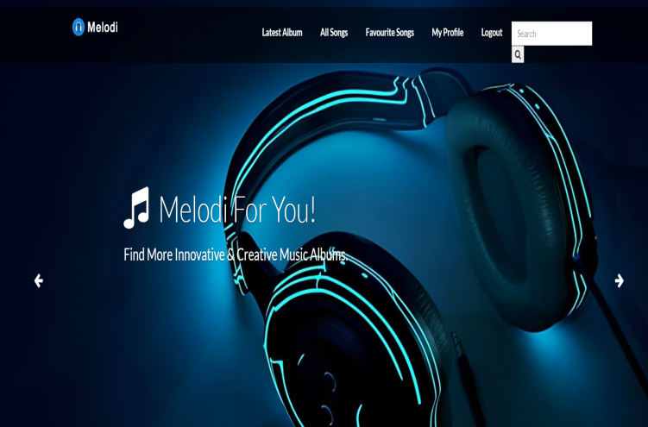
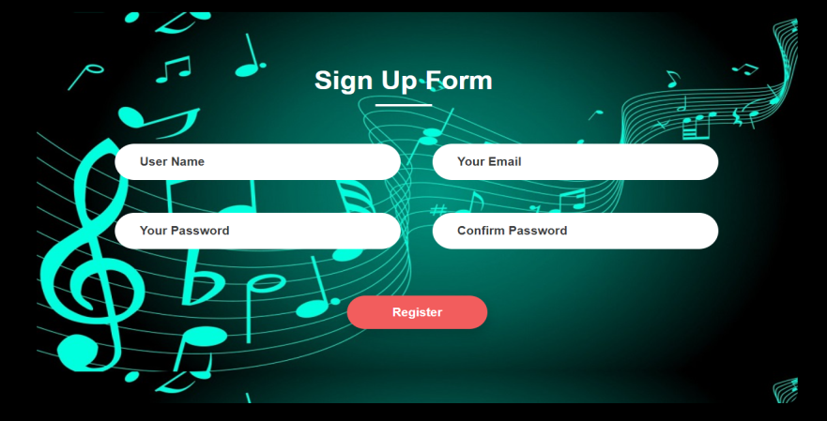
screenshots
HOME PAGE
The dashboard of user
REGISTER FORM
User can register to lesson to more songs

Slide 10
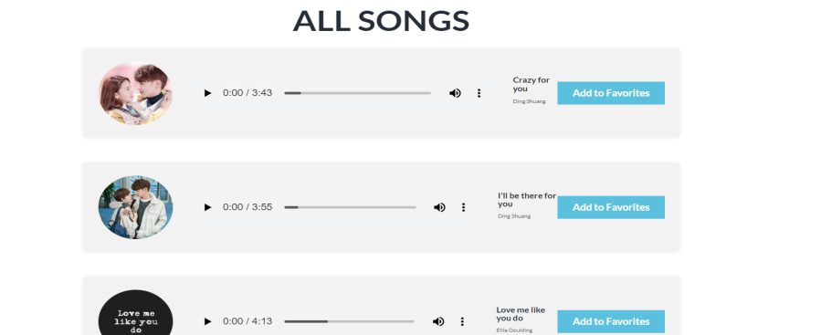
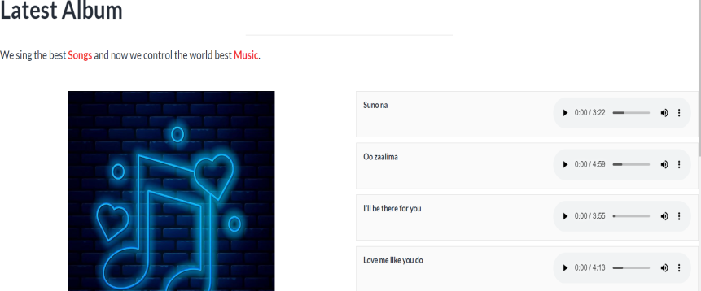
CONTINUES…
SONGS
User can lesson all the songs
LATEST SONGS
User can see the latest songs

Slide 11
FUTURE ENHANCEMENT
Payment integration
Advanced Research and filtering
Interactive Community Features

Slide 12
CONCLUSION
In conclusion, the music streaming website project aims to provide a comprehensive platform for users to explore, listen to, and enjoy their favorite music online. Throughout the presentation, we have covered various aspects of the project, highlighting its key features, technical requirements, and the challenges faced during development.
The music streaming website offers a user-friendly interface with intuitive navigation, allowing users to discover and browse through a vast collection of songs from different genres and artists. The website incorporates features such as search functionality, song categorization, and personalized recommendations, enhancing the user experience and ensuring that users can easily find the music they love.

Slide 13
THANK YOU

